Slide 1


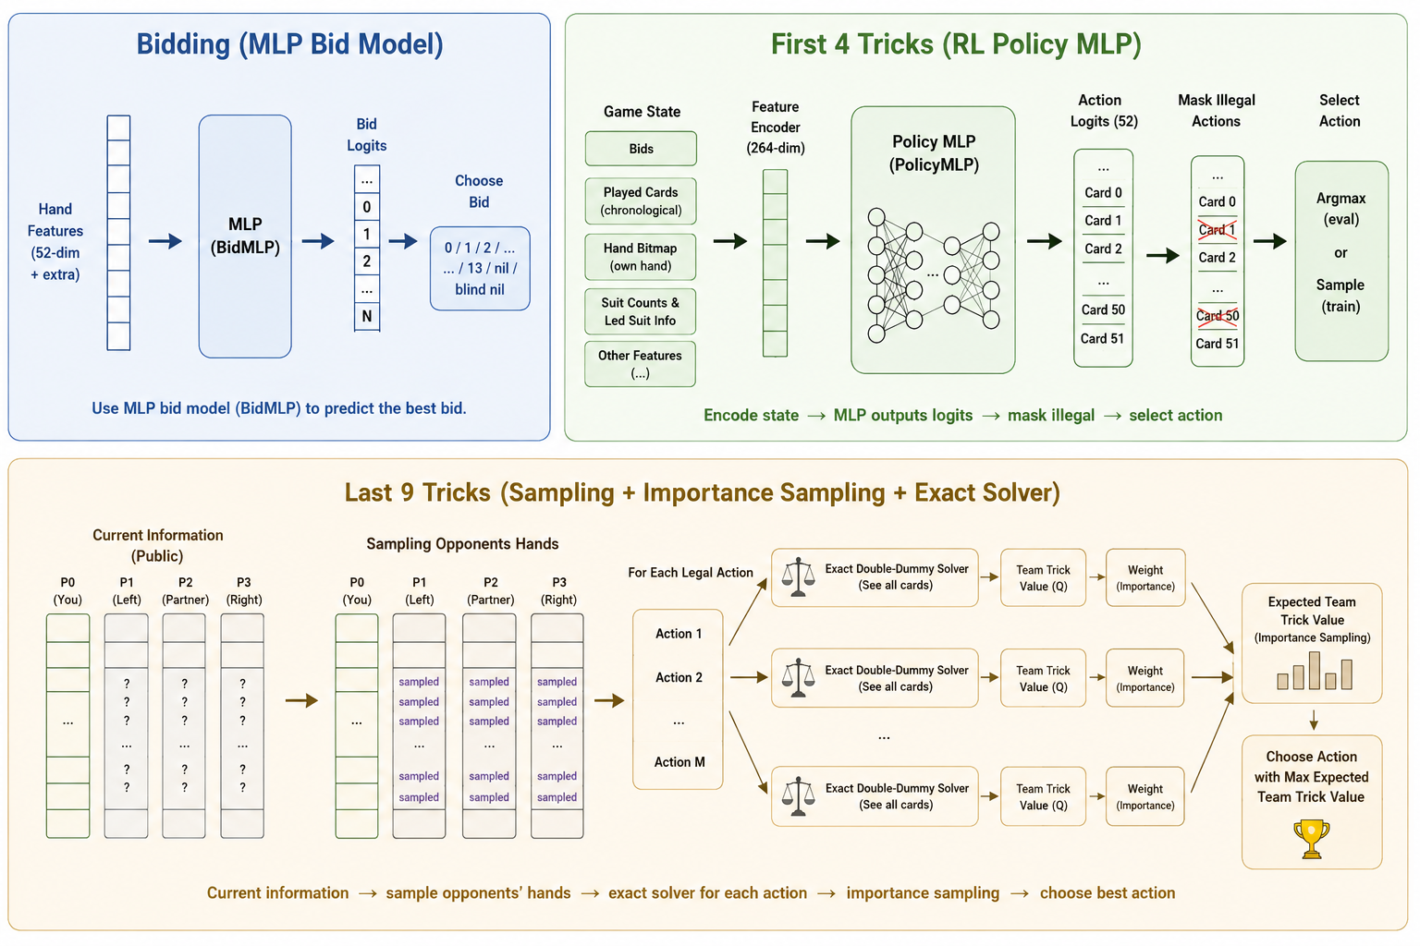
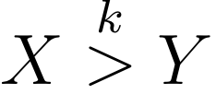
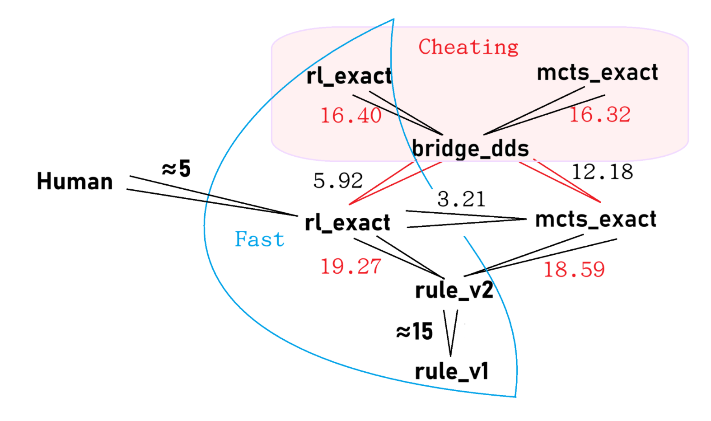
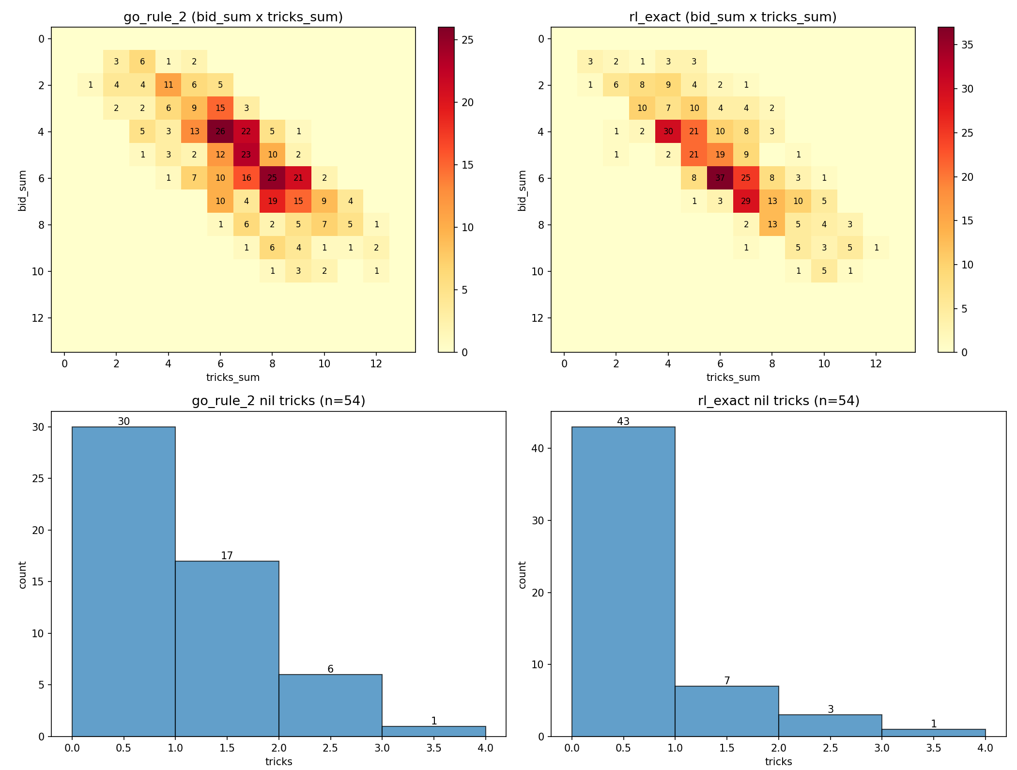
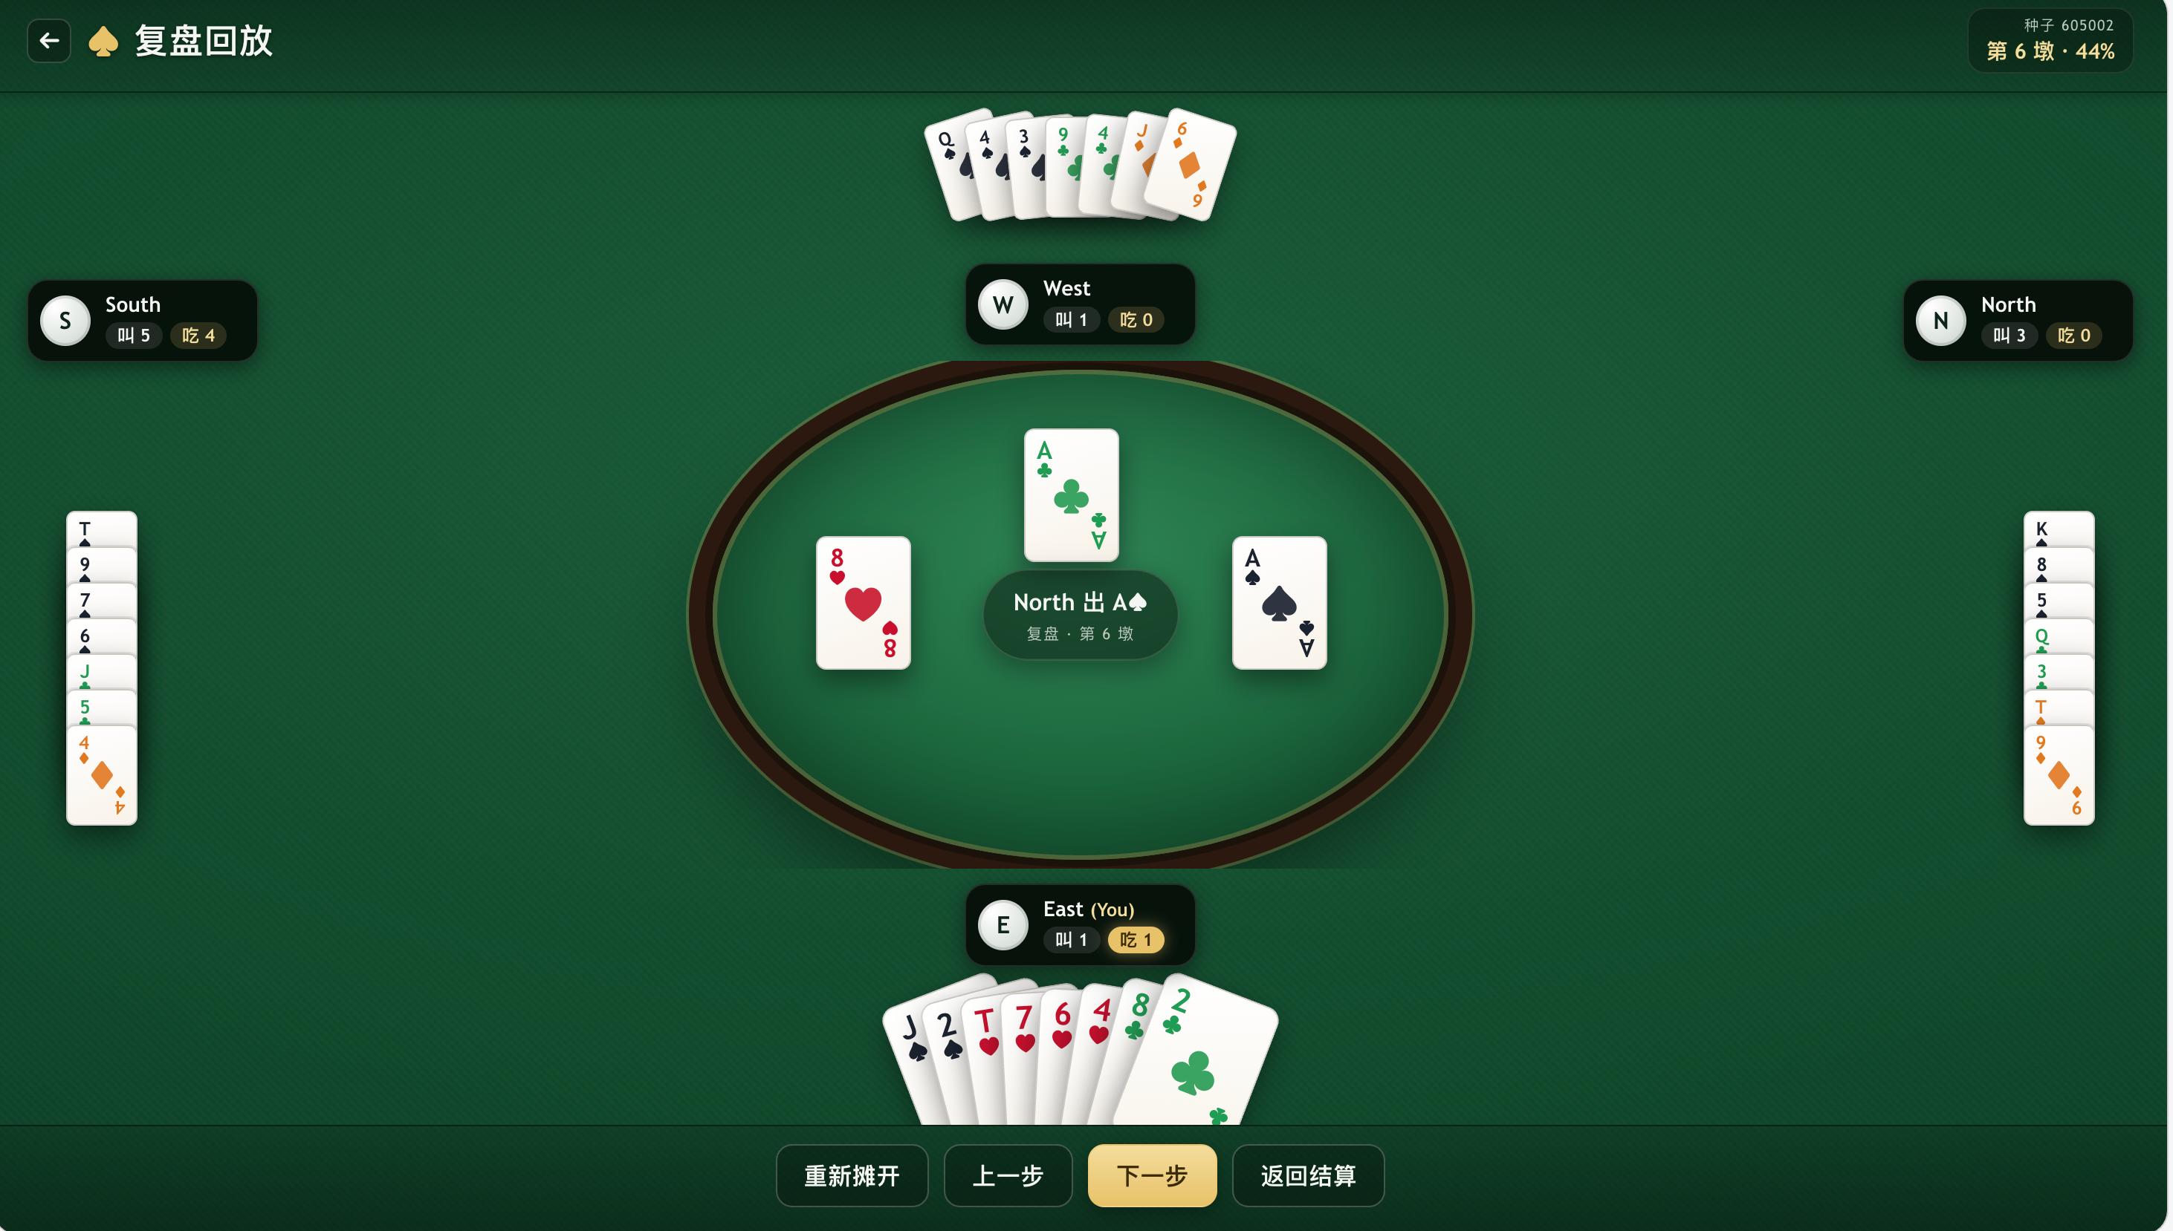
Towards Lightweight Human-Level AI in Trick-Taking Games
— An Odyssey in Spades
Haoren Luo, Bangjie Xu, Yueyang Wang
(Equal Contribution)
We have implemented a Reinforcement Learning policy MLP then sample-based exact solver Spades AI “rl_exact”. Evaluation with two skillful human players has shown that our model reaches human-level. When deployed on a single core CPU, the running time per action of our AI is approximately 5 seconds. The reinforcement learning training time is only 20 minutes.
Model Architecture
Evaluation Results (with the same bidding)
means when two X play against two Y,
it is expected that X can earn k more score than Y per game.
Experiment results with our strongest rule based model (with the same bidding, Team of Four)
GUI
Deep Learning 2026 Spring

